Slide 1
Traffic Sign Detection Using Lightweight Deep Learning Model
Group Members: Nibir Neelim (21241012)
Sakib Ul Haque (23341128)
Adib Reza (24141197)
Abrar Ahbabul Haque (24166003)

Slide 2
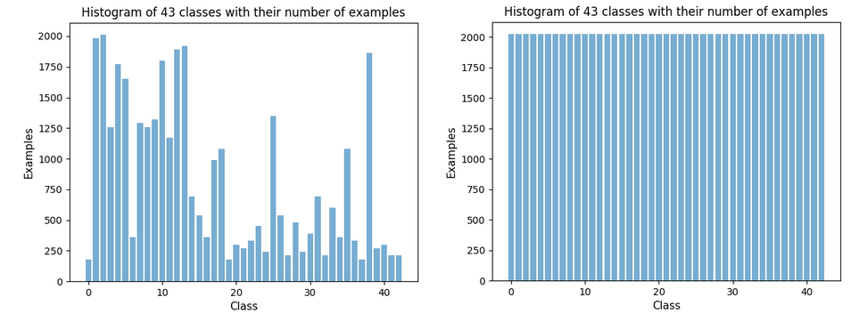
EXPLORATORY DATA ANALYSIS
Dataset Link: https://www.kaggle.com/datasets/valentynsichkar/traffic-signs-preprocessed/data
The dataset used in this paper consists of preprocessed traffic sign data in pickle format
The training dataset is balanced in all of its 43 classes of traffic signs through augmentation, as shown in the histogram
The original images were transformed with the adjustment of brightness and rotation for better generalization of the model
The dataset has diverse traffic signs with 86,989 training samples, 4410 images in the validation set and 12630 images in the test set. The order of the images are shuffled so that the model does not learn any order-dependent patterns from the training data.
Each image in the dataset is a 32x32 pixel with 3 color channels (RGB), but we have resized them to 224x224 for feeding into the models.

Slide 3
DESIGN
This paper will investigate the performance of some lightweight deep learning architectures like MobileNet V3 and compare against more complex architectures like ResNet-152 for traffic sign recognition.
Each image in both models is resized to 224x224 pixels to ensure consistent data with the same dimension is received in the input layer
The models will use the training data to learn and adjust its weight
Validation data is used to analyze the model’s performance to tune hyperparameters for avoiding overfitting
The test data will determine the overall final performance of the model for its effectiveness in real life scenarios
For each of the red, green and blue channels, the pixel values of all the images ranging from 0 to 255 were rescaled in the range between 0 and 1 to speed up the learning process

Slide 4
ARCHITECTURE
MobileNet V3 Large model architecture is used that is highly optimized for its performance in mobile devices for its reduced size and complexity
The model was also initialized with a parameter that uses the pre-trained weights on the ImageNet dataset so that model is given knowledge about the weights that have already been trained in a large dataset
The MobileNet model is customized by adding several layers that would transform its feature map from output into the predictions of the 43 classes of traffic signs
This output is then passed through a fully connected Dense layer with 512 units to learn non-linear transformation of the features where the RELU activation function was used.
Another Dense layer is added with 43 units equaling the number of classes as the output layer which uses softmax activation function so that the output can be represented as probabilities

Slide 5
ARCHITECTURE
Resnet-152 is a deep convoluted neural network used in the classification of images.
In this model we used the weights pre-trained on the ImageNet-1K dataset version 2
The ResNet model is customized by having additional fully connected layers with 512 output features and a rectified linear unit (ReLU) activation function
The final output layer has 512 input features and 43 output features where log softmax activation is used to provide log probabilities for the classification
Batch normalization is applied to accelerate the convergence.

Slide 6
METHOD
Categorical cross entropy is used as the loss function as the model has to deal with categorical classification tasks of 43 classes where the labels are one-hot encoded.
The learning rate is set at 0.001 for epochs less than 5 and it is decreased to 0.0005 for epochs between 5 and 10. This adjustment of learning rates enables the model to converge faster in the initial phases with higher learning rate and fine-tune better in the later stages with lower learning rate
For the first 10 epochs, all of the layers are set to “trainable”. In the next 10 epochs, the model is trained again, but only the batch normalization layers are frozen to maintain the statistics learned from the original training data.
This is done for fine-tuning the model.

Slide 7
METHOD
In ResNet-152, each channel of the image is normalized by using the same mean and standard deviation values as pre-trained on ImageNet images
Cross entropy loss function and Adam optimizer is used with a learning rate of 0.001 to update the parameters of the fully connected layers
Model was trained for 20 epochs where on each epoch the entire dataset is trained once
In the first phase of the model, only the custom final classification layers are trained from epochs 1 to 10 where the parameters of the base model are frozen to prevent them from being updated as the initial layers have already learned useful representations
In the second phase after epoch 10, all layers of the model are unfrozen except the batch normalization layers.
The number of workers is set to 4 to parallelize data loading for faster processing time during training.

Slide 8
RESULTS
MobileNet V3 achieved very high training and validation accuracies
The test accuracy of this model reached approximately 98.53% which suggests that the model is effectively generalizing to unseen data
ResNet-152 had high training accuracy but low validation accuracy
After evaluating on the test set, the model achieved an accuracy of 61.11% which suggests that the model is overfitting.
The model may be improved with lower learning rates.

